Slide 1

Group - 2
Excel dashboard
Tableau dashboard
Power bi dashboard
Sql query

Slide 2
About Company -
Adventure Works Cycles, is a large, multinational manufacturing company. The company manufactures and sells metal and composite bicycles to North American, European and Asian commercial markets. While its base operation is in Bothell, Washington with 290 employees, several regional sales teams are located throughout their market base.

Slide 3
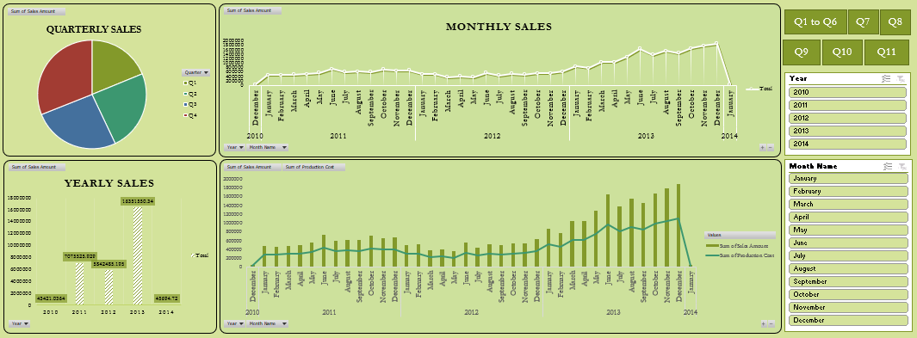
EXCEL DASHBOARD

Slide 4
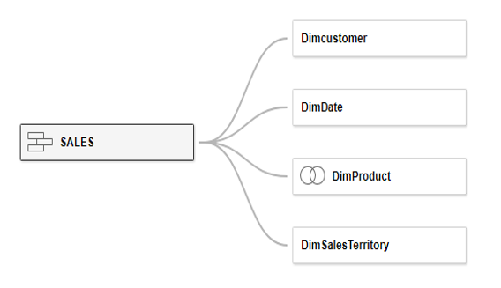
DATA MODELLING

Slide 5
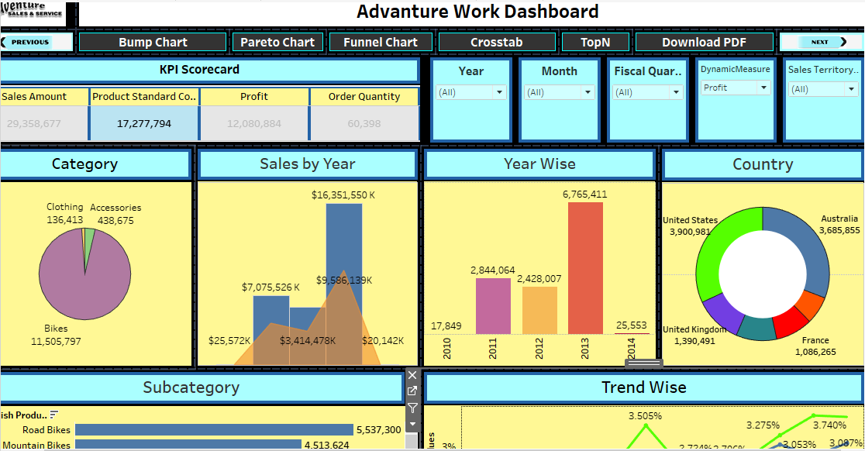
TABLEAU DASHBOARD

Slide 6
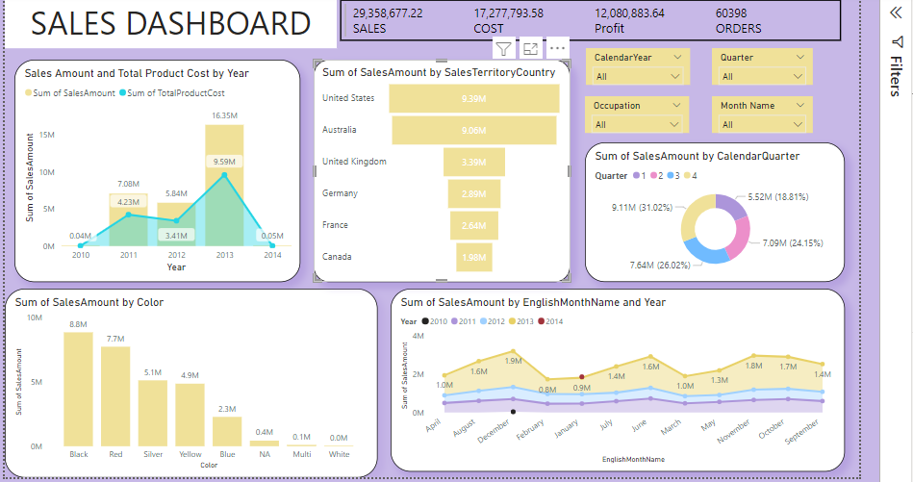
POWER BI DASHBOARD

Slide 7
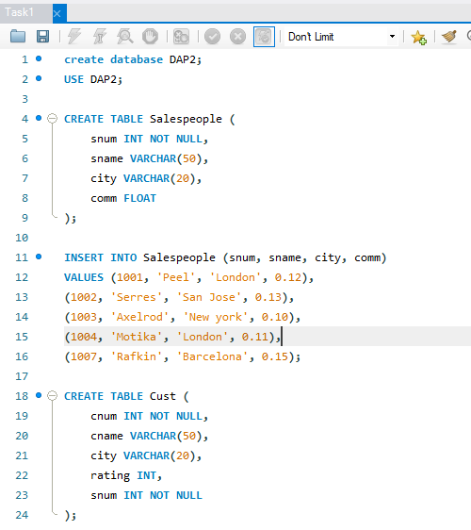
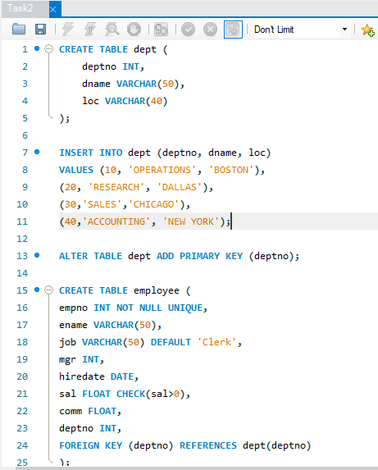
SQL QUERY

Slide 8
Thank you
GROUP – 2
Pranali Thombare

